Slide 1



INSTITUTE - UIE
DEPARTMENT- ACADEMIC UNIT-2
Bachelor of Engineering (Computer Science & Engineering)
Subject Name: Introduction to Problem Solving
Code:23CSH-101
Loop Control structure in C
DISCOVER . LEARN . EMPOWER

Slide 2


Introduction to Problem Solving
Course Objectives
The course aims to provide exposure to problem-solving through programming.
The course aims to raise the programming skills of students via logic building capability.
With knowledge of C programming language, students would be able to model real world problems.

Slide 3



CO Number | Course Outcome
CO1 | Remember the concepts related to fundamentals of C language, draw flowcharts and write algorithm/pseudocode.
CO2 | Understand the way of execution and debug programs in C language.
CO3 | Apply various constructs, loops, functions to solve mathematical and scientific problem.
CO4 | Analyze the dynamic behavior of memory by the use of pointers.
CO5 | Design and develop modular programs for real world problems using control structure and selection structure.

Slide 4
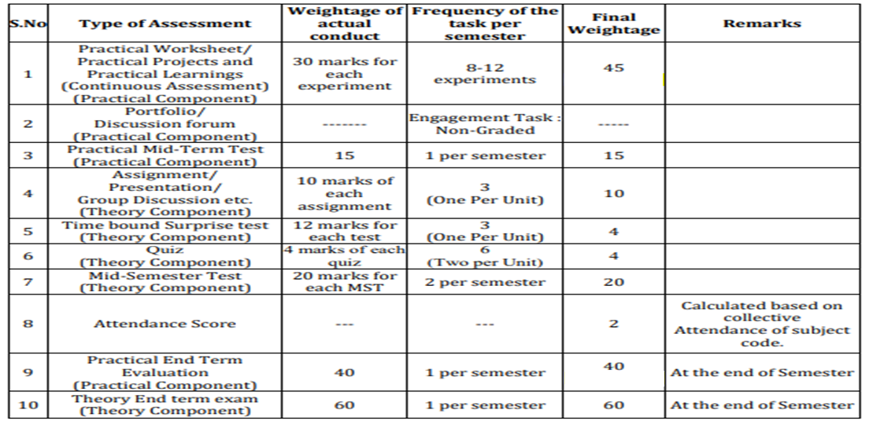
Scheme of Evaluation

Slide 5
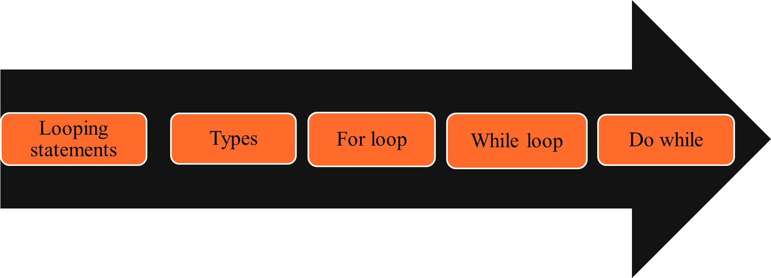
Contents

Slide 6
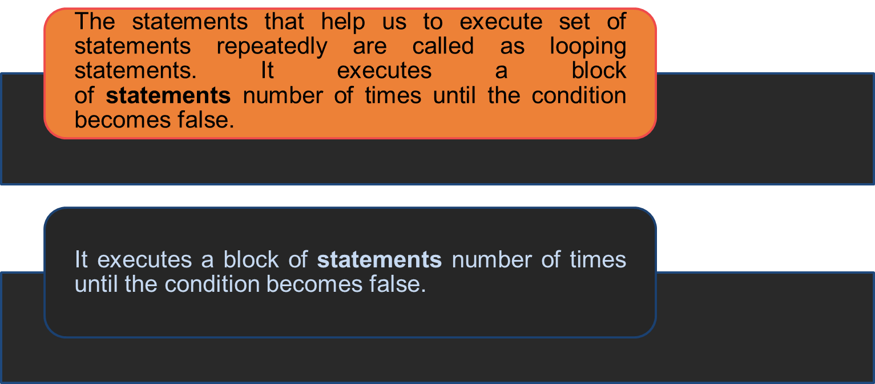
Looping Statements
I/O Statements

Slide 7
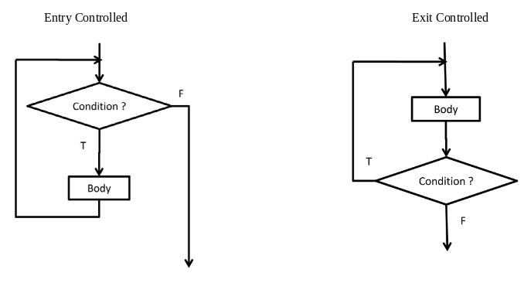
I/O types
Types of Looping statements
Entry controlled loop or Pre-Test Loop: In the entry controlled loop or Pre-Test loop, the condition is checked before we start and at the beginning of each iteration of the loop. If the condition is true, we execute body of loop; if the control expression is false, we terminate the loop.
Examples: while statement and for statement
Exit controlled loop or Post-Test Loop: In the exit controlled loop or Post-Test loop, the condition is checked after or at the end of each iteration of the loop. If the condition is true, we repeat body of loop; if the condition is false, we terminate the loop.
Examples: do…while statement

Slide 8
Loops Definition & Syntax
Statements | Definition & Syntax
while | It is a most basic loop in C programming. It has one control condition, and executes as long the condition is true. The condition of the loop is tested before the body of the loop is executed. Syntax: while (condition) { statement(s); Incrementation; }
for | C for loops is very similar to a while loops in that it continues to process a block of code until a statement becomes false, and everything is defined in a single line. The for loop is also entry -controlled loop. Syntax: for ( init; condition; increment ) { statement(s); }
Do while | C do while loops are very similar to the while loops, but it always executes the code block at least once and furthermore as long as the condition remains true. Syntax: do { statement(s); }while( condition );

Slide 9
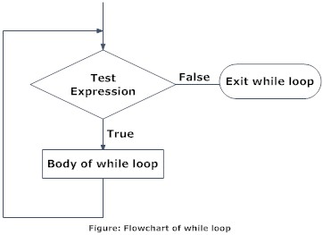
While loop
Working:
step1: The loop variable is initialized with some value and then it has been tested for the condition.
step2: If the condition returns true then the statements inside the body of while loop are executed else control comes out of the loop.
step3: The value of loop variable is incremented/decremented then it has been tested again for the loop condition.

Slide 10
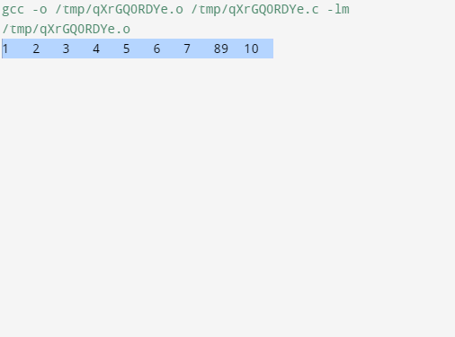
Example 1
Example 1 Program to print first 10 natural numbers.
#include<stdio.h>
void main( )
{
int x;
x = 1;
while(x <= 10)
{
printf("%d\t", x);
x++;
}
}

Slide 11
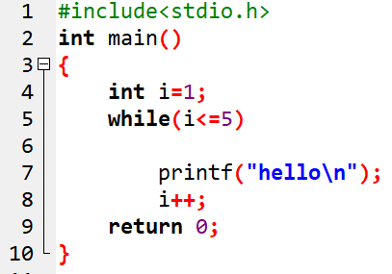
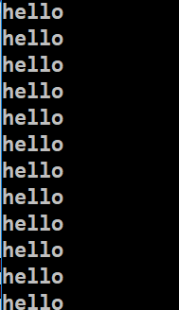
Example 2
Infinite loop

Slide 12
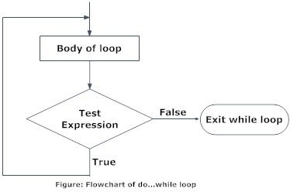
Do-while loop
Working:
1. First we initialize our variables, next it will enter into the Do While loop.
2. It will execute the group of statements inside the loop.
3. Next we have to use Increment and Decrement Operator inside the loop to increment or decrements the value.
4. Now it will check for the condition. If the condition is True, then the statements inside the do while loop will be executed again. It will continue the process as long as the condition is True.
5. If the condition is False then it will exit from the loop.

Slide 13
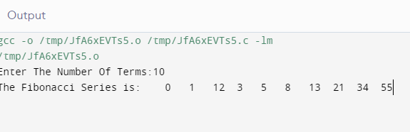
Example
Program to print fibonacci series
#include<stdio.h>
void main()
{
int n,f,f1=-1,f2=1;
printf(" Enter The Number Of Terms:");
scanf("%d",&n);
printf(" The Fibonacci Series is:");
do
{
f=f1+f2;
f1=f2;
f2=f;
printf(" \n %d",f);
n--;
}while(n>=0);
}

Slide 14
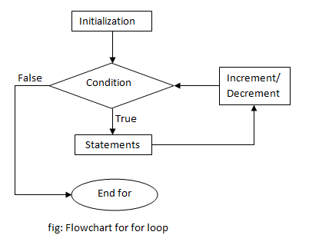
For loop
Flowchart of continue statement
Working:
Step 1: First initialization happens and the counter variable gets initialized.
Step 2: In the second step the condition is checked, where the counter variable is tested for the given condition, if the condition returns true then the C statements inside the body of for loop gets executed, if the condition returns false then the for loop gets terminated and the control comes out of the loop.
Step 3: After successful execution of statements inside the body of loop, the counter variable is incremented or decremented, depending on the operation (++ or –)

Slide 15
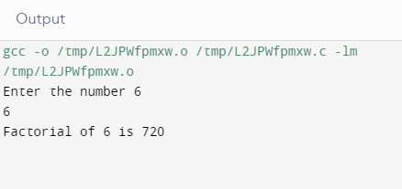
Example
Program to print factorial of a number
#include<stdio.h>
#include<conio.h>
void main()
{
int fact, i, n;
fact = 1;
printf("Enter the number\t");
scanf("%d" , &n);
for(i = 1; i <= n; i++)
{
fact = fact*i;
}
printf("Factorial of %d is %d", n , fact);
getch();
}

Slide 16
Summary
for
It continues to process a block of code until a statement becomes false, and everything is defined in a single line.
while
It has one control condition, and executes as long the condition is true.
Do while
It always executes the code block at least once and furthermore as long as the condition remains true.

Slide 17

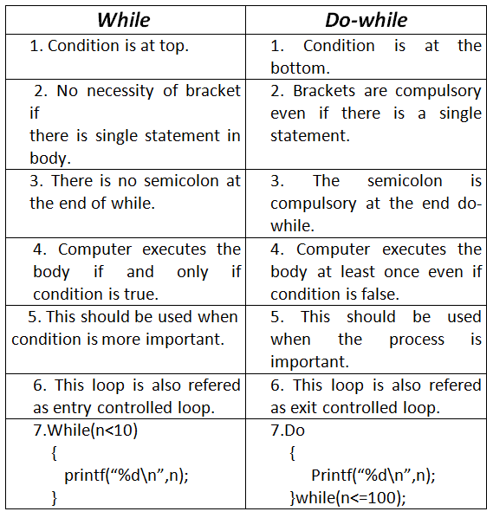
FAQ
1. What is the difference between while loop and do-while loop?

Slide 18
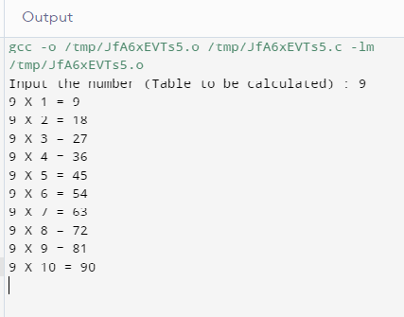
FAQ
Q2 Write a program to print table of a number enter by user.
#include <stdio.h>
void main()
{
int j,n;
printf("Input the number (Table to be calculated) : ");
scanf("%d",&n);
printf("\n");
for(j=1;j<=10;j++)
{
printf("%d X %d = %d \n",n,j,n*j);
}
}

Slide 19
Assessment Questions
1. Program to check Armstrong number.
2. Write a c program to check a number is prime number or not.
3. Write programs for the following :
a) program to read 10 numbers from keyboard and find their sum and average.
b) to calculate the simple interest.
4. do-while loop terminates when conditional expression returns?
A One
B ZERO
C NON-ZERO
D NONE OF THE ABOVE
5. What will be the output of following program ?
#include <stdio.h>
void main()
{
int cnt=1;
do
{ printf("%d,",cnt);
cnt+=1;
}while(cnt>=10);
printf("\nAfter loop cnt=%d",cnt);
printf("\n")

Slide 20

Discussion Forum
Program takes an integer from the user and calculates the number of digits.
For example: If the user enters 231967, the output of the program will be 6.

Slide 21

References
Book References: http://www2.cs.uregina.ca/~hilder/cs833/Other%20Reference%20Materials/The%20C%20Programming%20Language.pdf
http://www.freebookcentre.net/programming-books-download/The-Basics-of-C-Programming.html
Vedio Lecture: https://www.studytonight.com/c/loops-in-c.php
https://www.youtube.com/watch?v=4gFfGzpDGFw
https://spocathon.page/video/lecture-20-implementation-loops-statement-contd
https://study.com/academy/lesson/nesting-loops-statements-in-c-programming.html
Websites: https://www.programiz.com/c-programming/c-for-loop
https://www.tutorialspoint.com/cprogramming/c_loops.htm
https://beginnersbook.com/2014/01/c-loops-examples/

Slide 22

THANK YOU

